Slide 1
Integrating Sustainability Reporting in Government Accounting
PRESENTED BY:
Lindy Bodewig
Title: Chief Director: Technical Support Services
Division – Office of the Accountant-General
Date: 20 Feb 2024
1st AFRICAN ASSOCIATION OF ACCOUNTANTS GENERAL ANNUAL CONFERENCE 2024

Slide 2
Sustainability reporting in government accounting holds significant importance in Africa for several reasons:
Promoting Transparency and Accountability
Supporting Sustainable Development Goals (SDGs) / Agenda 2063
Attracting Investment and Aid
Managing Environmental Resources
Addressing Social and Economic Inequities
Enhancing Public Sector Efficiency
Fostering Local and Global Partnerships
Meeting International Reporting Standards

Slide 3
The role of government accounting in sustainability reporting is multifaceted and crucial for ensuring transparent, accountable, and sustainable governance
Data Collection and Management
Integration of Financial and Non-Financial Information
Performance Measurement and Evaluation
Budgeting and Resource Allocation
Risk Management
Stakeholder Engagement
Compliance with Reporting Standards

Slide 4
Integrating sustainability reporting poses several challenges
Data Collection and Management
Standardization and Consistency
Capacity Building and Resource Constraints
Complexity of Reporting
Data Quality and Reliability
Stakeholder Engagement
Regulatory and Institutional Barriers
Political Will and Leadership
Measuring Impact and Effectiveness

Slide 5
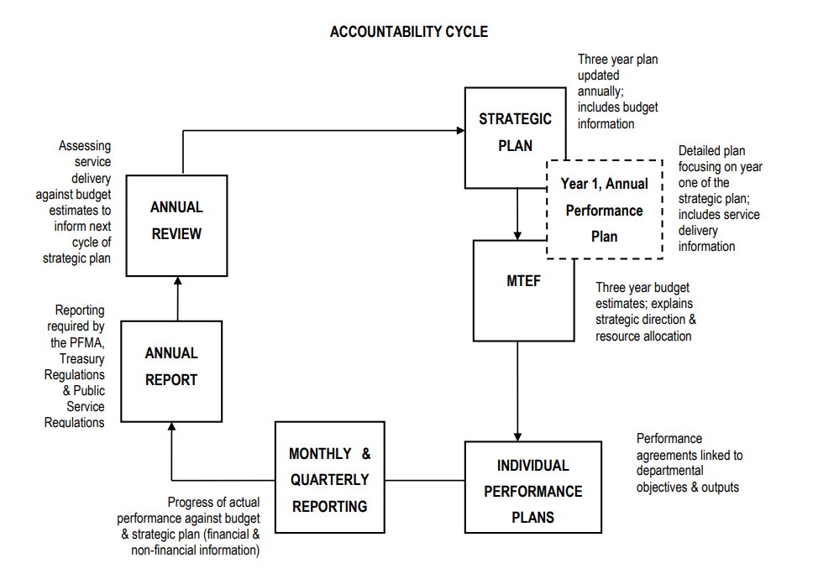
Integrating sustainability in the accountability cycle
Paris Agreement
SDGs / Agenda 2063
Development Funding
National Development Plan
National budget and expenditure frameworks
Climate change & presidential cc
Climate budget tagging
Capital and appraisal guidelines
Macro economic frameworks
Economic strategy
Long-term fiscal and economic modelling
Carbon tax
Just transition
Sustainable finance
Debt markets and equity oversight
Disaster risk management and funding
Green finance taxonomy
Green finance

Slide 6
Importance of government’s chart of accounts
Linking the chart of accounts to sustainability reporting requirements involves aligning financial data with non-financial sustainability indicators to provide a comprehensive view of the government’s ESG performance
Fund
Function/ program
Economic classif.
Cost centre
Project
Geo. region
What
General funding source
E.g. grants, donor funds
Specific key activities of an entity
Revenue, expenditure, assets & liabilities
Organisation units
Projects undertaken by entity
Usually long-term in nature
Geographic location of where expenditure is incurred
Funding for specific sustainability goals
Activities linked to sustainability goals
E.g. conservation
Costs incurred on specific programs, such as conservation costs
Organisational units involved in or responsible for sustainability programs
Infrastructure projects linked to sustainability prog or funding
Communities or areas benefiting from the programs or funding
How

Slide 7
Existing reporting guidance and what to expect from the IPSASB…..
RPG 3: Reporting Service Performance Information
RPG 3: Reporting Service Performance Information
IPSAS 24: Presentation of Budget Information in the Financial Statements
RPG 2: Financial Statement Discussion and Analysis
IPSAS 24: Presentation of Budget Information in the Financial Statements
IPSAS 18: Segment Reporting

Slide 8
Existing reporting guidance and what to expect from the IPSASB…..
Climate related disclosures (ISSB publication combined with GRI)
Natural resources → Standard on natural resources (under development), Exposure draft on Exploration for and Evaluation of Mineral Resources, also Stripping Costs in the Production Phase of a Surface Mine

Slide 9
Thank you

